Slide 1

International Regulations for the Prevention of Collisions at Sea
a.k.a - Rules of the Road, ColRegs or IRPCS
(38 Rules + Annexes)
You have a duty to avoid a collision

Slide 2
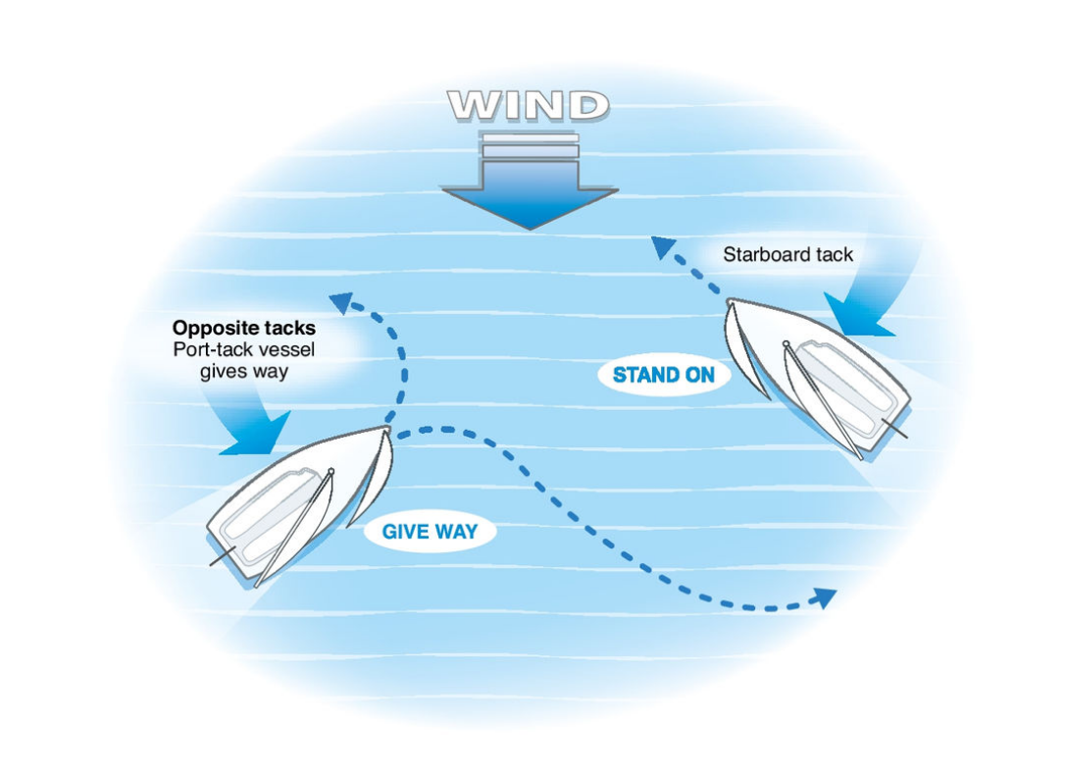
Starboard Tack
(Rule 12)

Slide 3
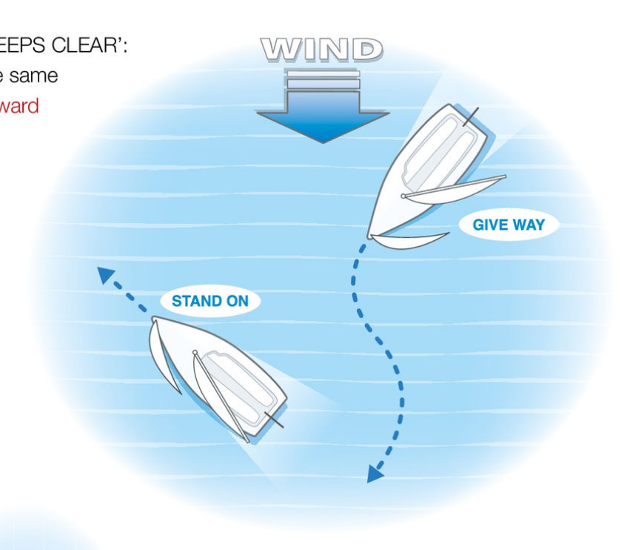
Windward Boat
(Rule 12)

Slide 4
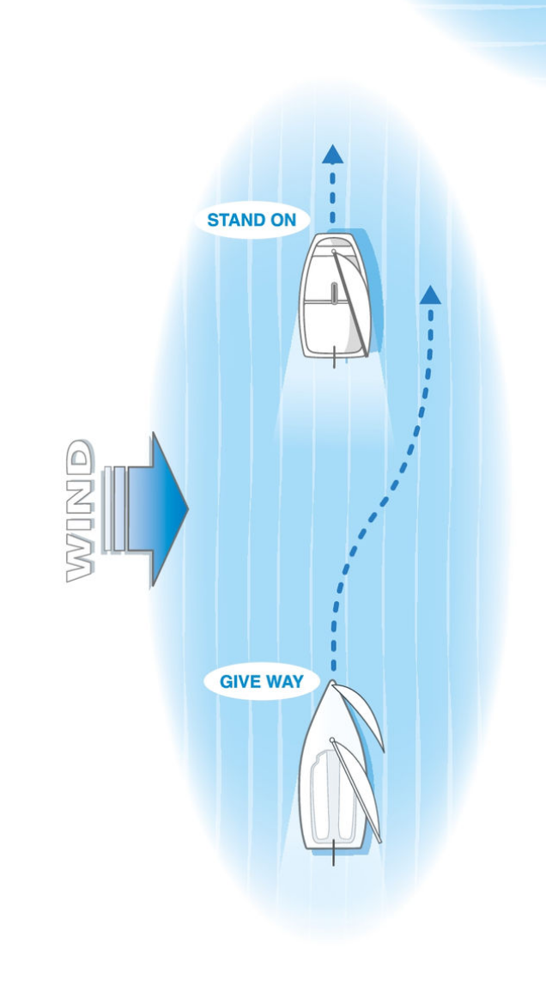
Overtaking Boat
(Rule 13)

Slide 5
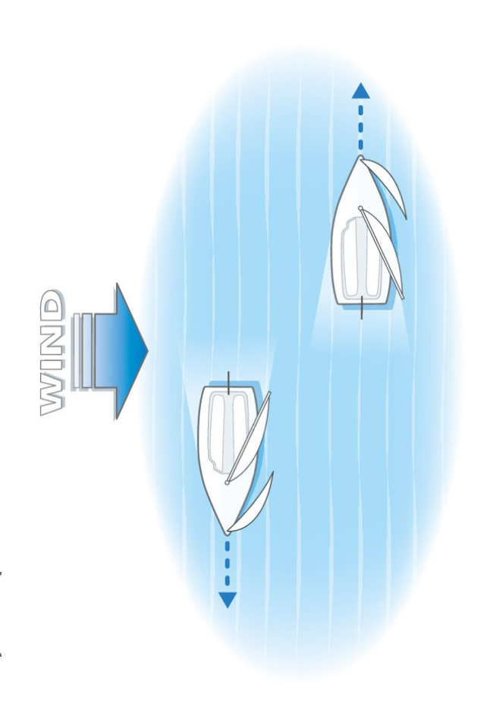
Passing in a Channel
(Rule 9)

Slide 6
Power Gives Way to Sail
Power Gives Way to Sail - includes rowing and paddling
Obviously Large Vessels have right of way and can’t move as fast
Turn to starboard, pass port to port
Make your intentions clear (Rule 8)
Keep a constant watch (Rule 5)
Some extra rules for racing … but we can leave those for now!

