Slide 1


Slide 2
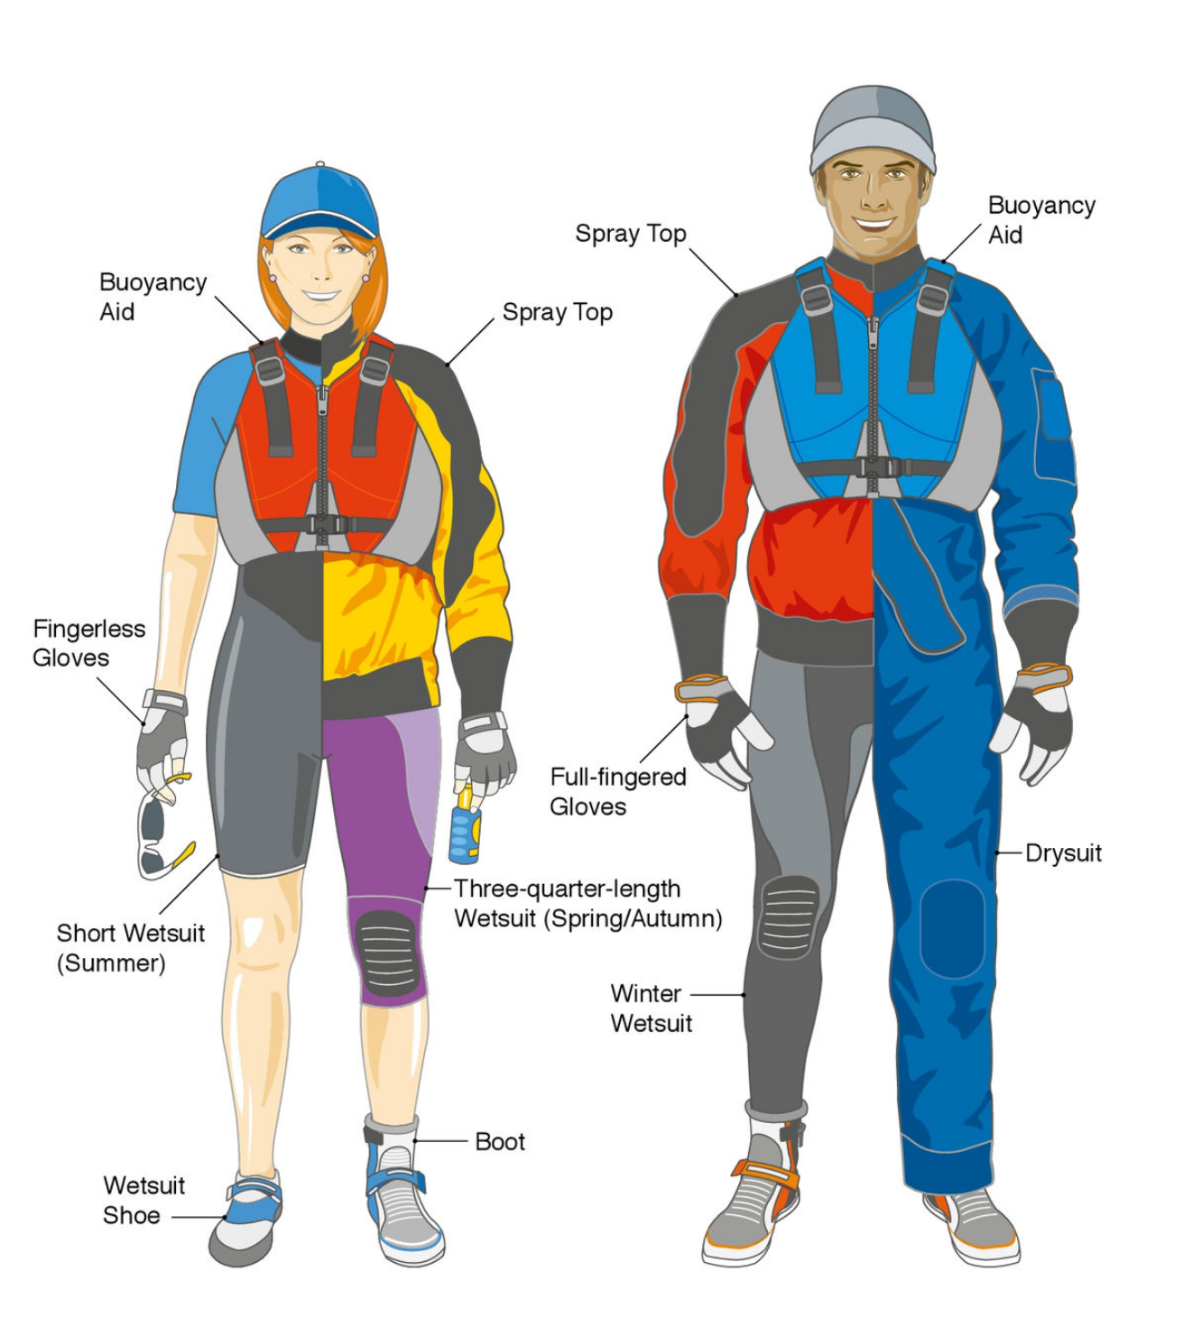

Slide 3
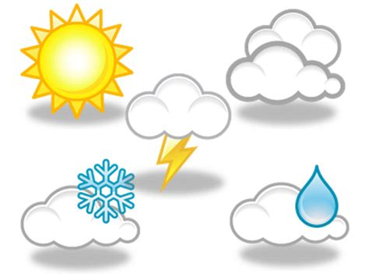
Clothing
Weather appropriate
What’s the weather doing?
Variables to consider
Hot / Cold
Wet / Dry
Sunny / Cloudy
Windy / Still
Wind chill / Feels Like
Water Temp
Time of year
Time of year - temp change rate
Changes during the day
Cooler by and on the water
Type of activity and how active you are
Time on and off the water
Time in and Out of the water
Type of craft / Likely to capsize
Your personal comfort and preference

Slide 4
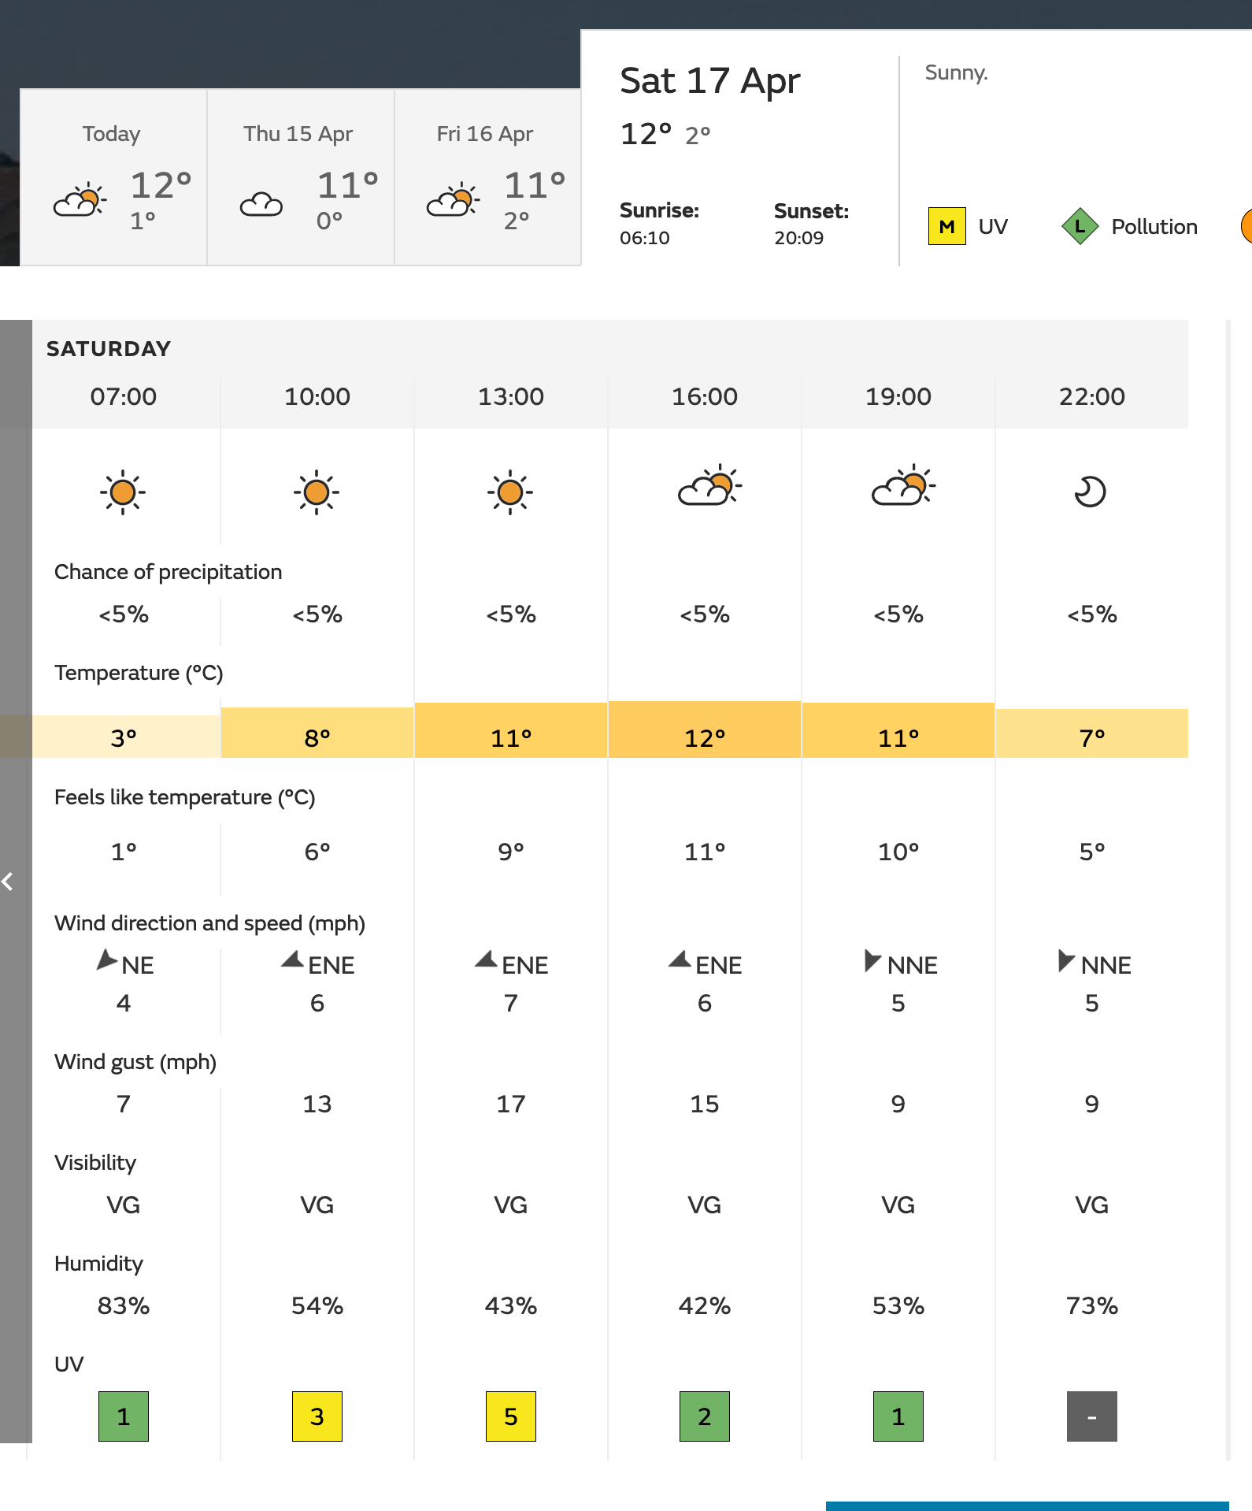






Forecast
Check the right date
Water temp cold!
Sunny - Good News
No Real Rain
Cold to start but
warming slightly!
Great wind speed
East N.East could be cold
Mid UV - use sun cream

Slide 5
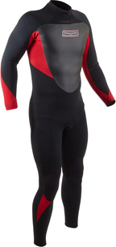
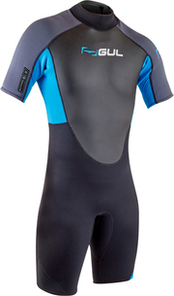
Wet Suites
Keep you warm in the water for longer
Thin layer of water is initially cold until body warms it up
Needs to be tight fitting to work
Won’t keep you dry
What else will you use it for?
Long / Medium / Short?
Depends on the weather conditions
Do you like exposed legs?
Shorties are best for warmer weather
2/3mm or 4/5mm?
Thickness provides thermal insulation
How long are you going to be in the water
When out of water how warm is the weather
Cost?
Entry level £20-£30
Mid Range £50 - £80
Top end £100-£300+
Sailing Specific?
strengthened areas knees / bottom
maybe more comfortable for sailing

Slide 6
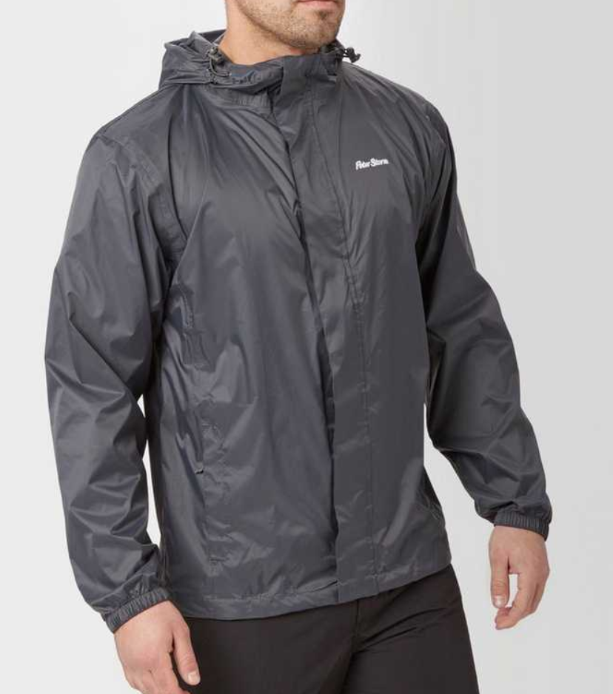
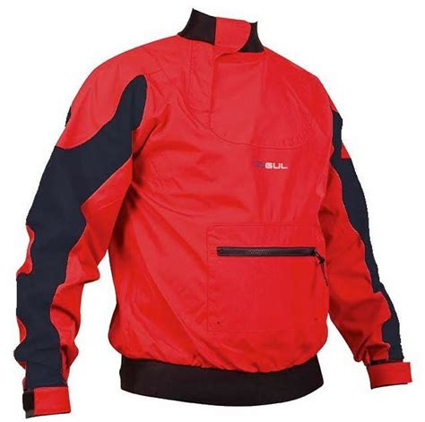
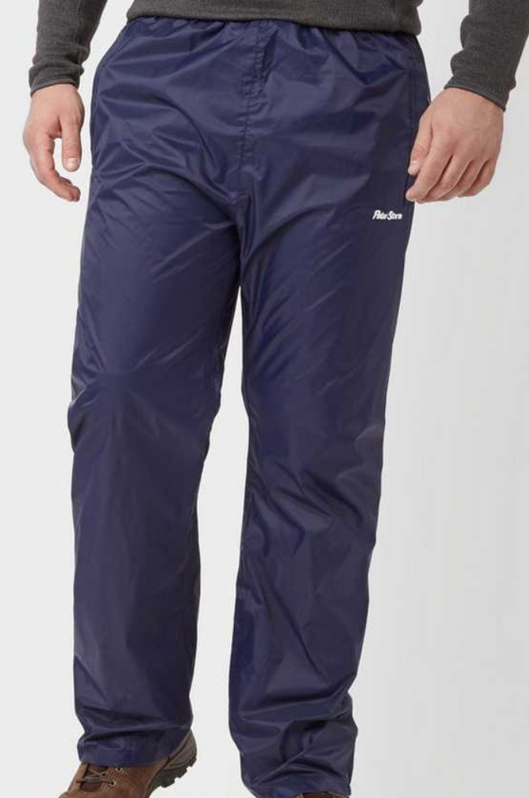
Keeping the wind out!
Spray Jackets
Pack away Jacket and Trousers
£18
£50

Slide 7
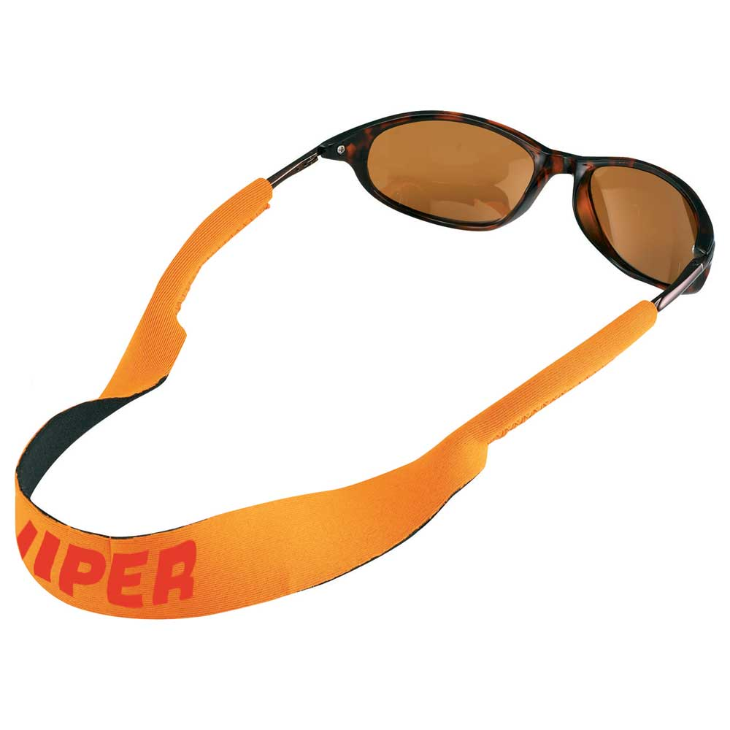
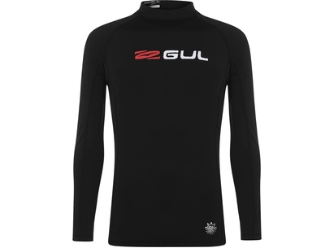
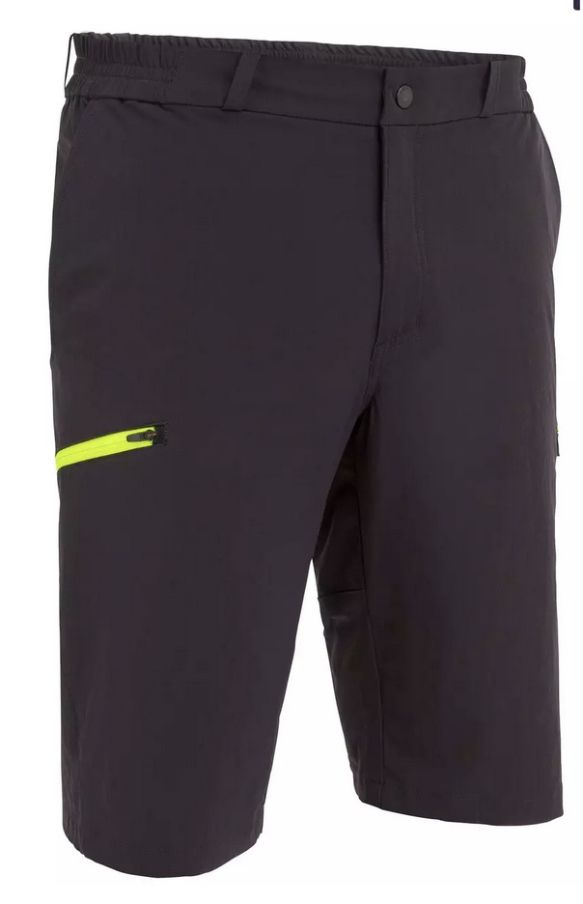
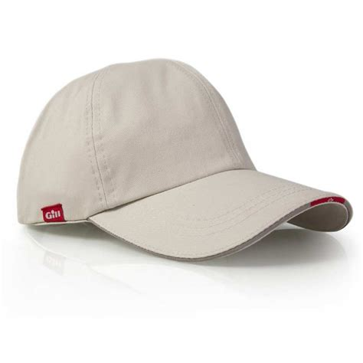
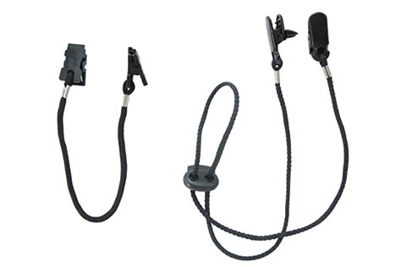
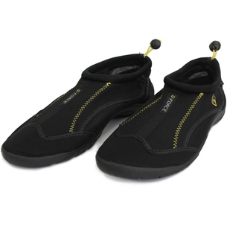
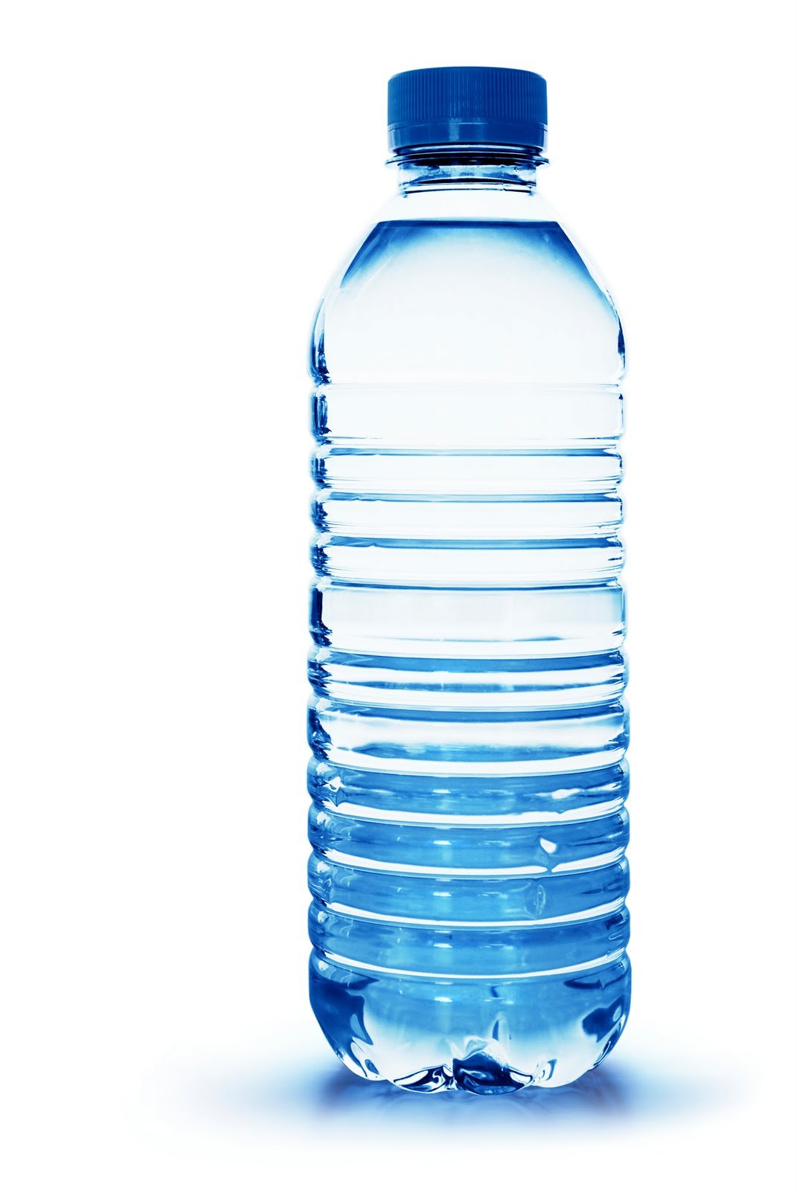
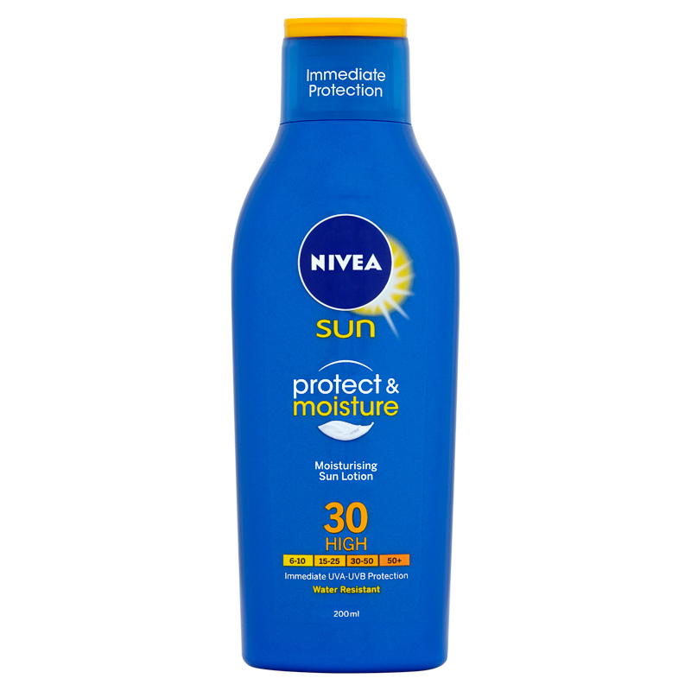
Hot Day + Warm water
T-shirt or Rash vest
Shorts
Hat
Sunglasses

Slide 8
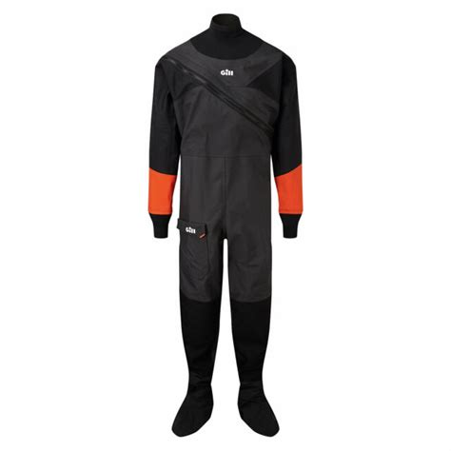
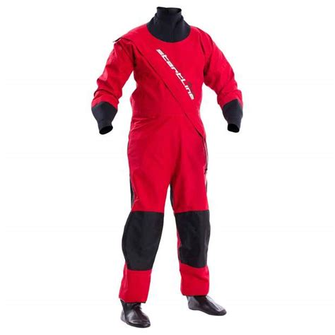
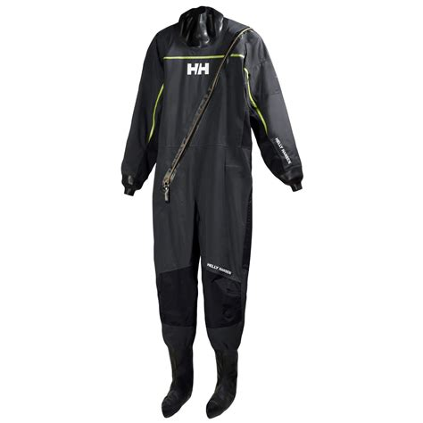
Dry Suits - If you sail a lot in the cold!
Expensive £350 plus
Need to sail lots to justify cost
Good for winter and cold water
Will keep you dry
Needs maintenance and care

Slide 9
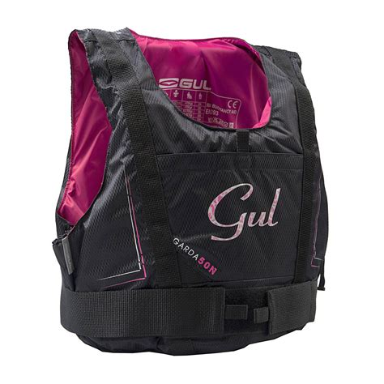
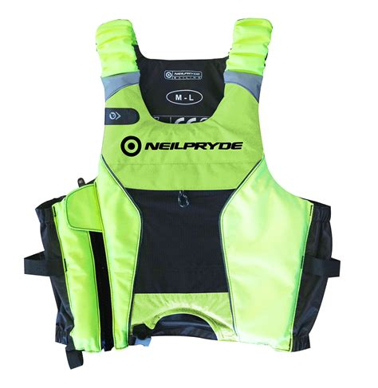
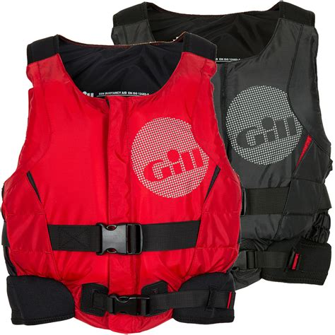
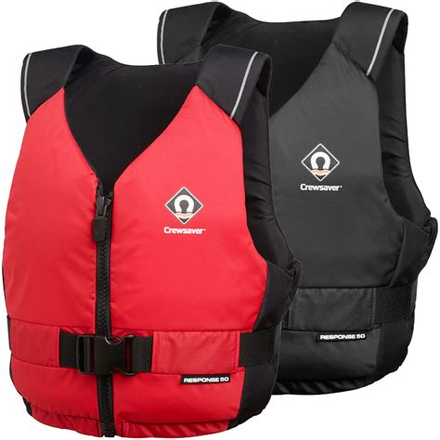
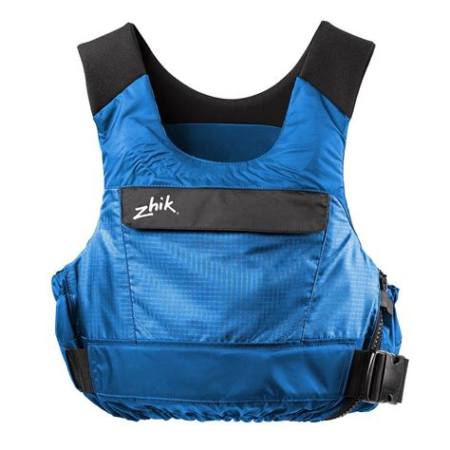
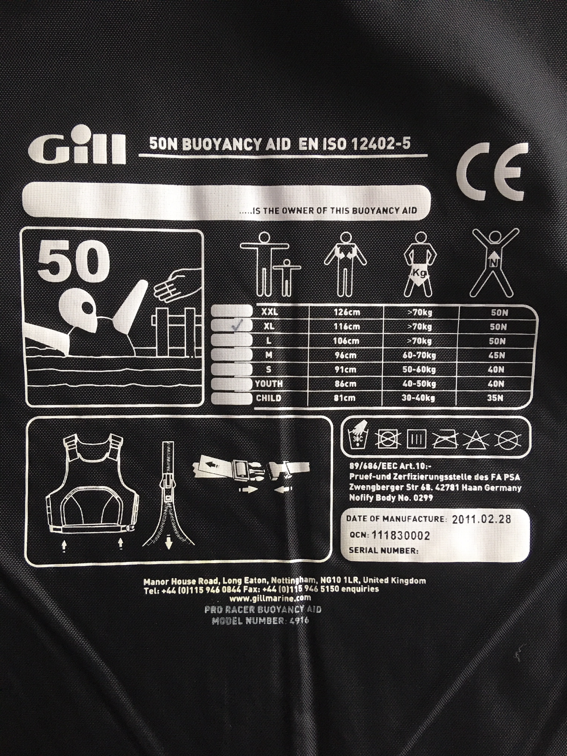
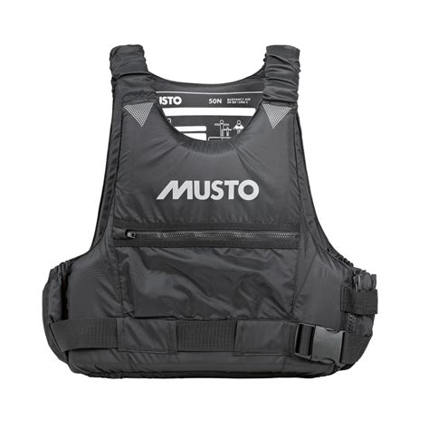
Buoyancy Aids (50N)
£30 - £90

Slide 10

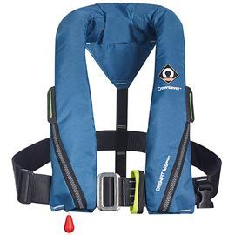
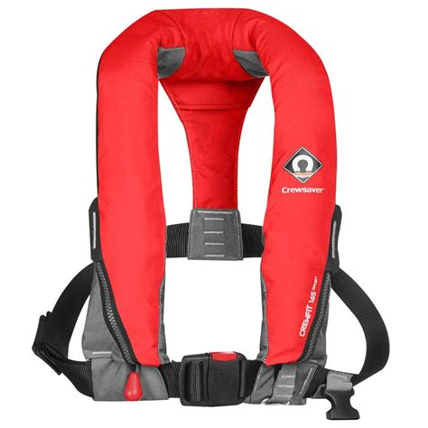
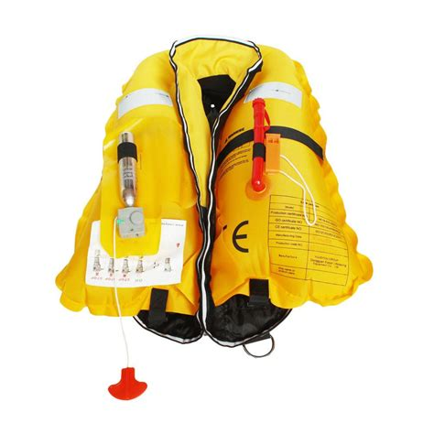
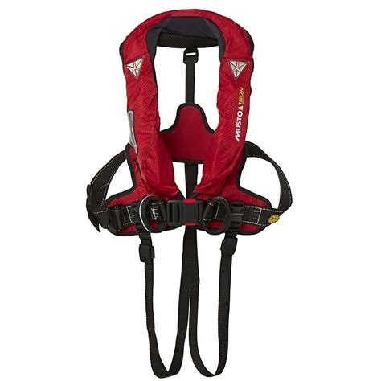
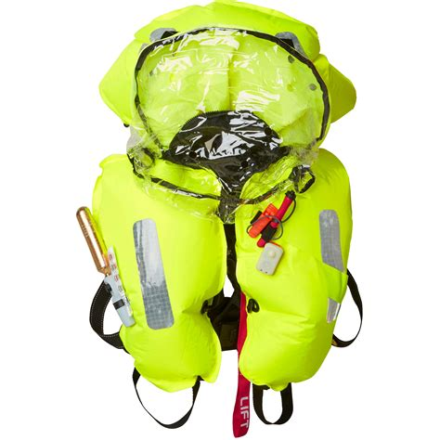
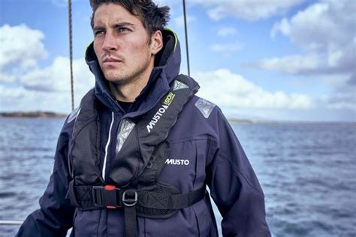
Life Vests (Not for Dinghy Sailing)

Slide 11
Any Questions?

