Slide 1
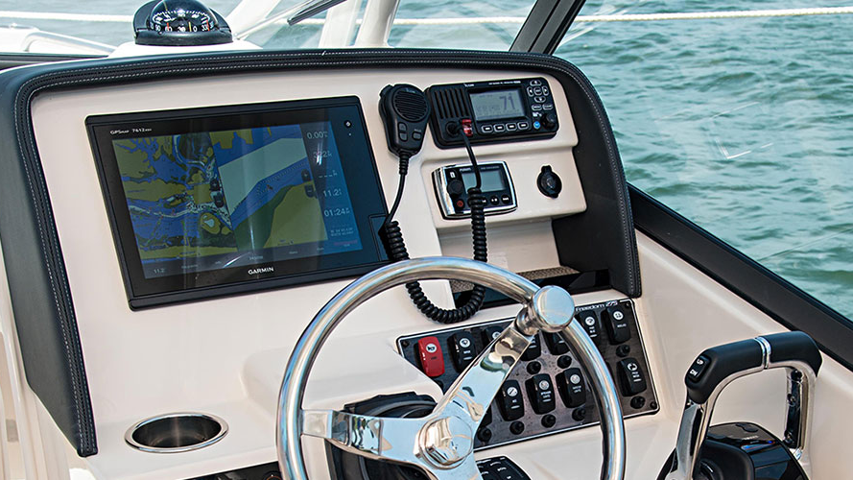
Powerboat level 2 - GPS
Overview
How GPS works
What does GPS do
How GPS can be used for navigation
Familiarisation, information available on GPS
Limitations of GPS

Slide 2
Introduction
This presentation introduces you to the use of GPS and Chart-plotters for use as navigation aids to a Powerboating level 2 standard. (Further courses are available which build on this knowledge, RYA Essential Navigation & Seamanship)
One thing to take away is that they are aids to enhance traditional navigation methods and should not be solely relied on.
Its good practice to carry paper charts and record passages in log books.

Slide 3
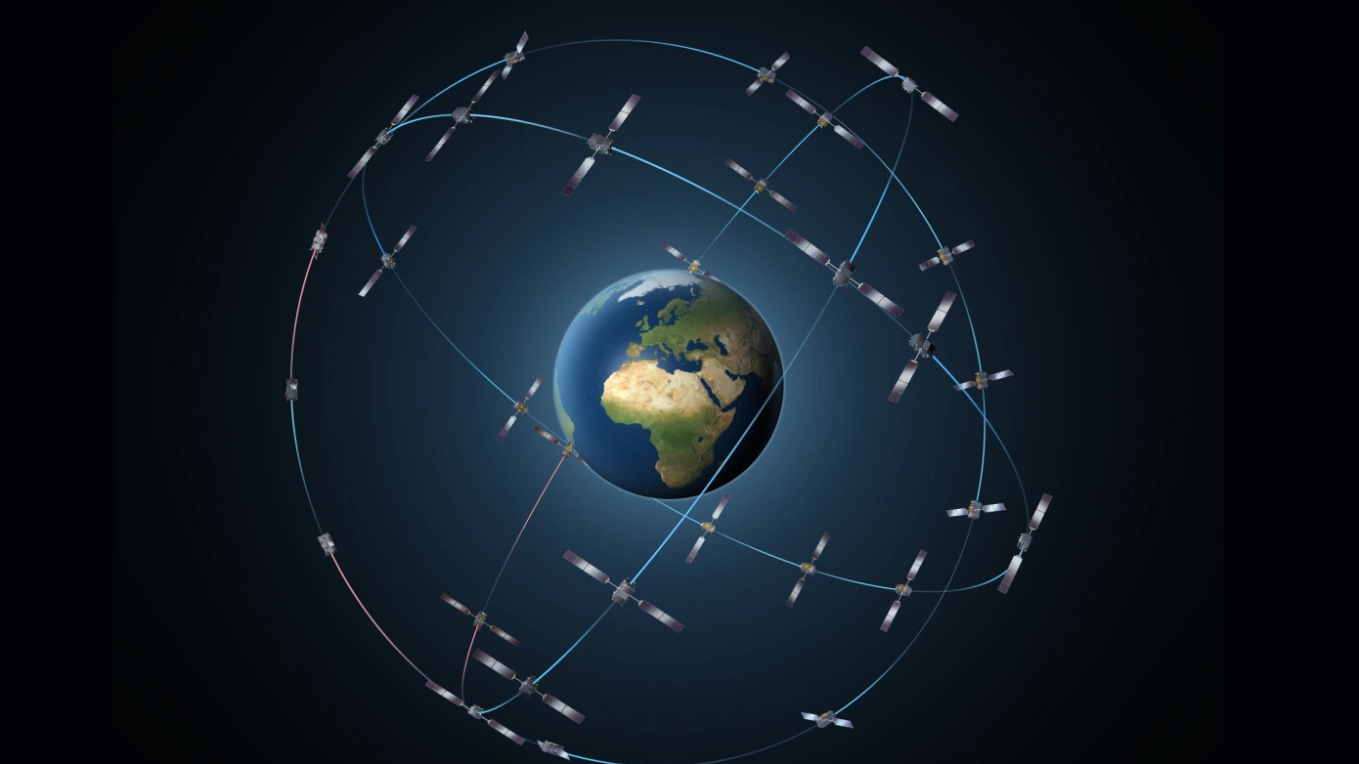
How GPS works
A GPS receiver obtains a fix from signals transmitted by orbiting satellites

Slide 4
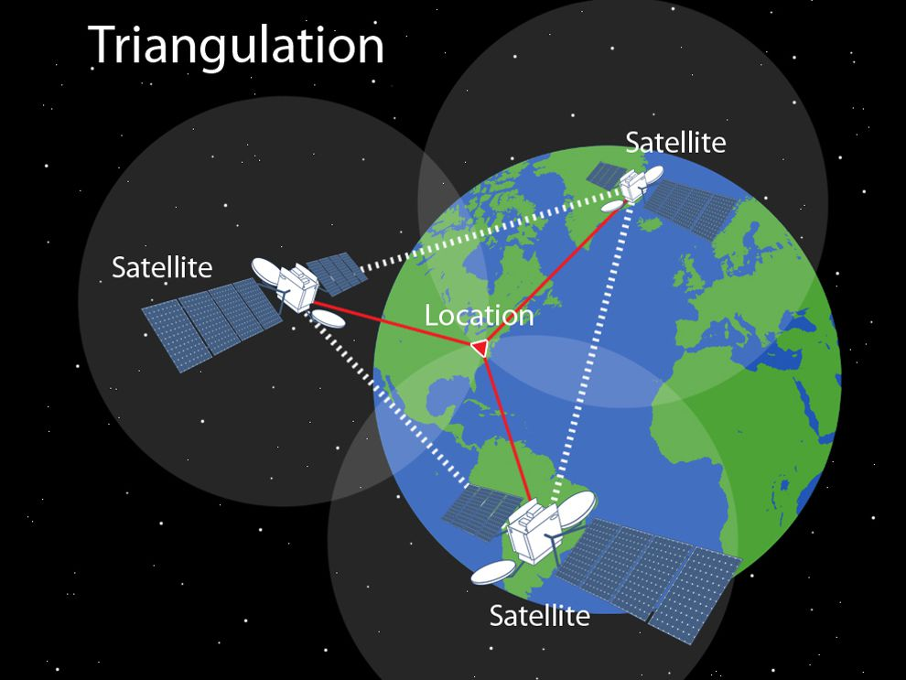
How GPS works
Triangulation
A global positioning system (GPS) device uses data from satellites to locate a specific point on the Earth in a process called trilateration. To trilaterate, a GPS receiver measures the distances to satellites using radio signals. Trilateration is similar to triangulation, which measures angles, depicted in this illustration.

Slide 5
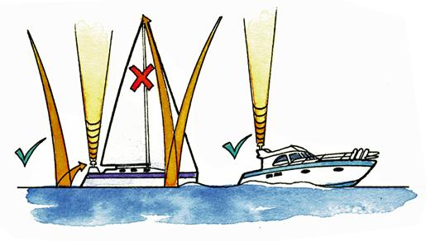
GPS aerials
The position of the GPS aerial is important.
Position low to avoid signal bounce
Ensure the aerial is not shielded in any way and has a clear view of the sky.

Slide 6
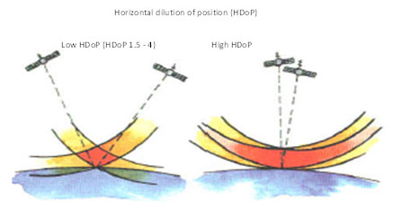
Horizontal Dilution of Position
If you need to check GPS accuracy, for example if you are using the unit in pilotage situations, look at the value of Horizontal Dilution of Precision (HDoP) on your GPS/chart plotter. Low values indicate a more accurate fix than high ones. Check your manual as some systems portray signal information differently.

Slide 7
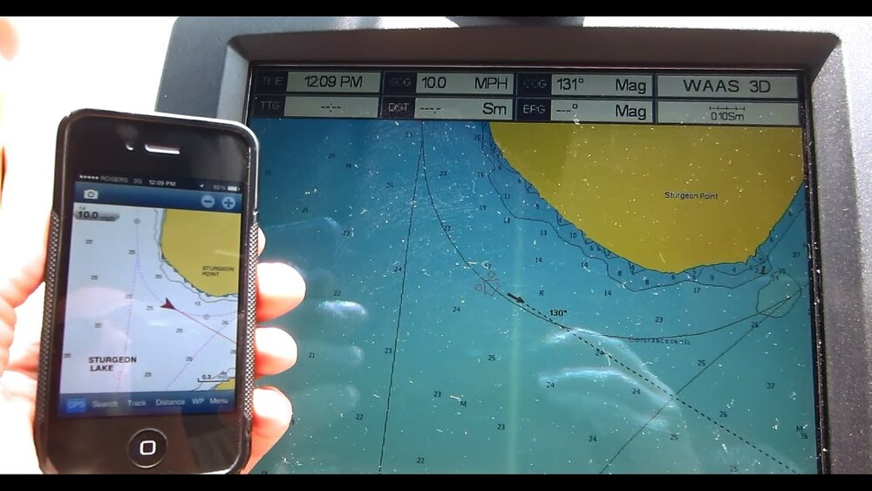
What does GPS do
Notes:
Questions to ask
What would you look for on the GPS to check the accuracy of the GPS position?
Would a low or high value indicate a more accurate fix?

Slide 8
What does GPS do
A GPS device allows us to pinpoint our current position as Latitude and Longitude.
The position shown on the GPS device can be accurate to about 3 meters depending on the type of receiver, number of satellites, physical obstructions and environmental conditions.
The software built into a GPS device allows us to:
  View our position on a chart
  Enter Waypoints and Routes
  Look at our track
  Look at tidal offsets and best course

Slide 9
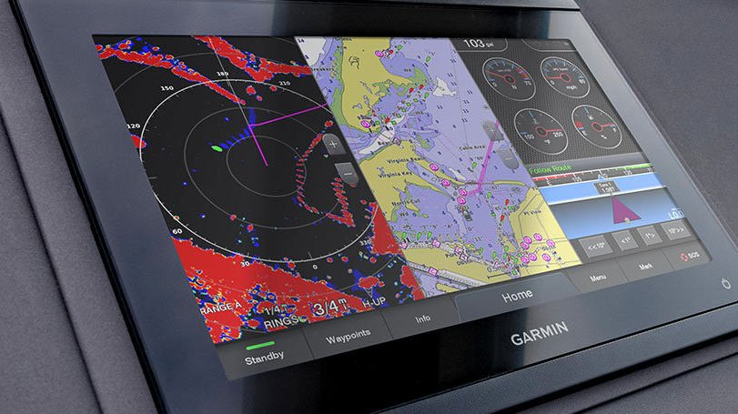
How can GPS be used for navigation
Through waypoint and routes, we can use GPS as an aid for navigation.
Notes:
Questions:
What factors can affect the accuracy of the GPS device?
Type of receiver
Number of satellites
Physical obstructions
Environmental conditions
What does a GPS allow us to do?
View our position
Enter waypoints and routes
Look at our track
Look at tidal offsets and best course

Slide 10
Waypoints
Waypoints are a tool to help you navigate.
Waypoints are positions on the earths surface expressed in Latitude and Longitude
They can be stored in the memory of the GPS that are used as reference point

Slide 11
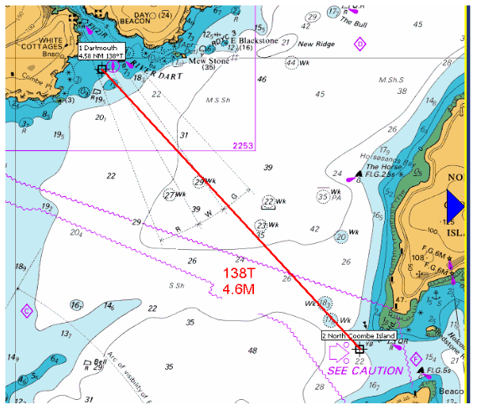
Waypoints
Plotting two waypoints on a chart, from your current location to your destination will allow you to measure the true bearing and distance. This example shows 138 degrees and a distance of 4.6 NM

Slide 12
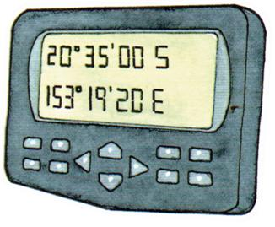
Waypoints
Care must be taken when inputting positions into a GPS receiver.
It is easy to miss key Latitude and Longitude

Slide 13
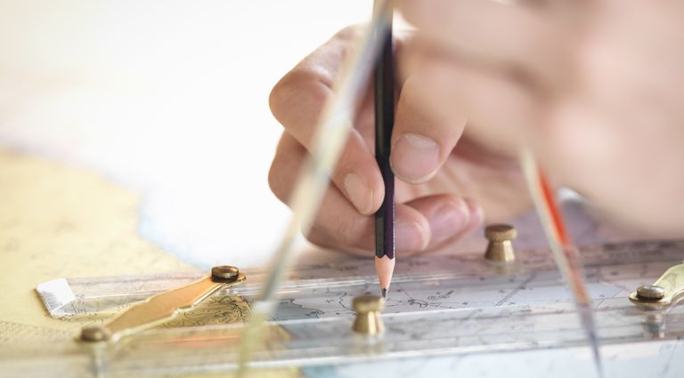
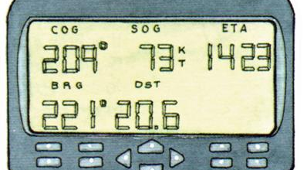
Waypoints
Before relying on GPS information such as distance (DTW) and bearing (BTW) to waypoint (WPT) check that it is correct by plotting on a chart

Slide 14
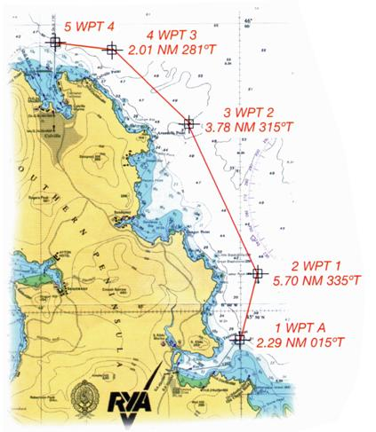
Routes
Entering a series of waypoints into a GPS to make a route.
Remember, always plot the waypoints on a chart and check the distances and bearings between them

Slide 15
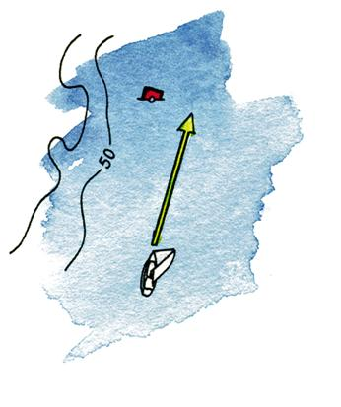
Routes
Using a fixed charted object (buoy) as a waypoint may end in disaster as there is a potential to hit it!
Plot your waypoints adjacent to rather than directly on charted objects

Slide 16
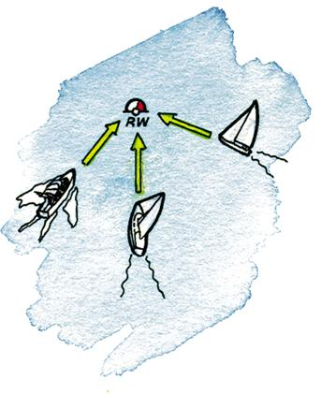
Routes
In busy areas, bear in mind that many other boats could be using the same waypoint.
Be vigilant!

Slide 17
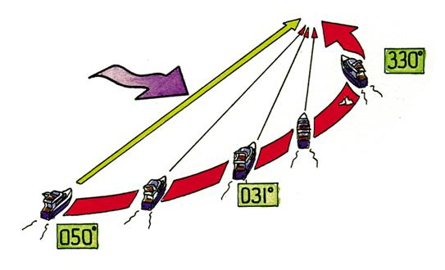
Routes
Note, GPSs doesn’t allow for tide
It may seem easy just to steer the bearing that the GPS gives you, but in cross tide you might be swept towards danger!

Slide 18
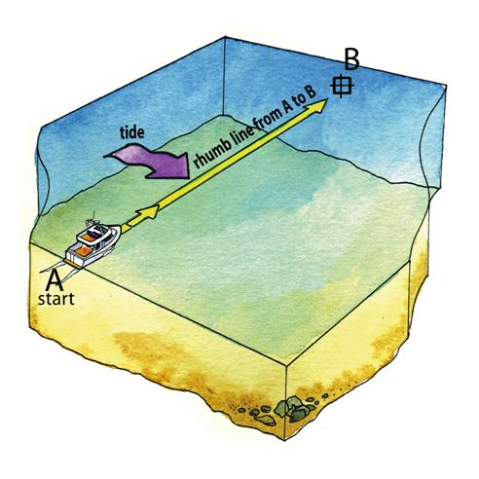
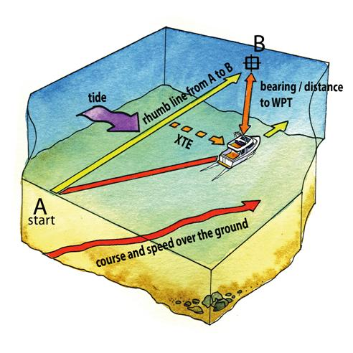
Routes
The Cross-Track Error (XTE) function shows your lateral distance from the rhumb line between two waypoints

Slide 19
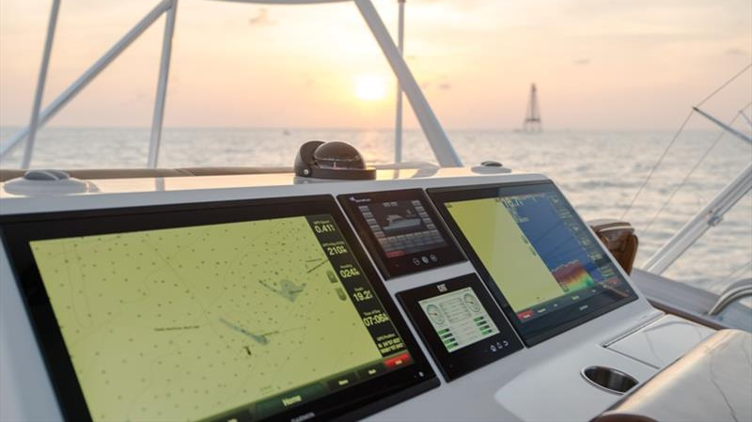
Familiarisation, information available on GPS
Notes:
Questions:
On a GPS how are waypoints expressed ?
As longitude and latitude
What are routes?
Sometimes its useful to use fixed charted objects as waypoint, but what should we consider when using these?
What is the purpose of the Cross-Track Error function

Slide 20
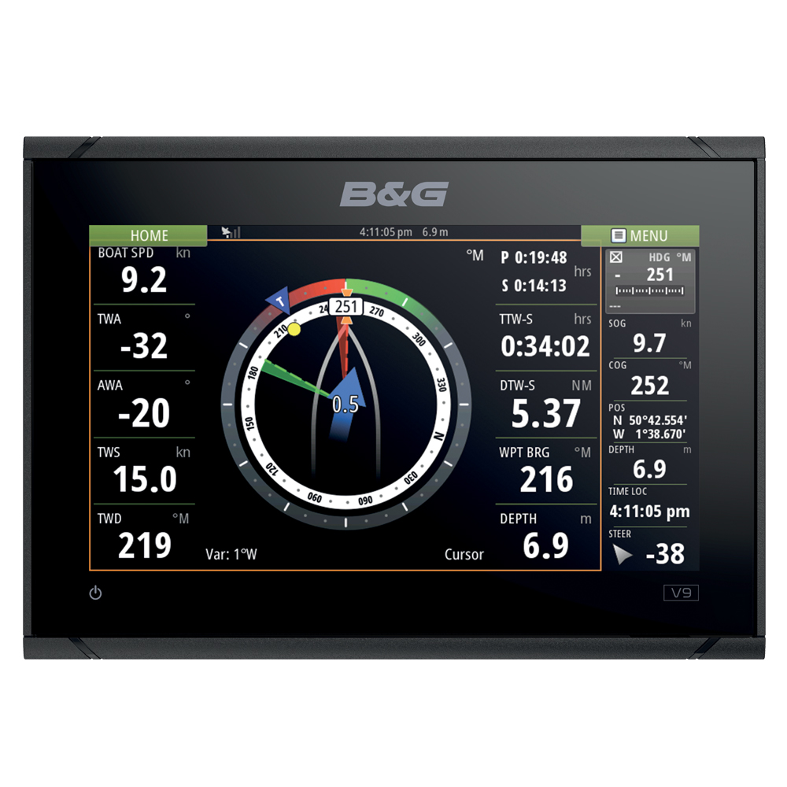
Information available on a GPS device
Heading
Speed Over the Ground (SOG), after tidal influence
Course Over the Ground (COG), after tide and leeway
Bearing To Waypoint (BTW), the bearing from one waypoint to another
Distance To Waypoint (DTW), the distance of one waypoint from another
Cross-Track Error (XTE) – how much you have deviated from the direct route when travelling between two waypoints
Time To Waypoint (TTW)
Time To Destination (TTD)

Slide 21
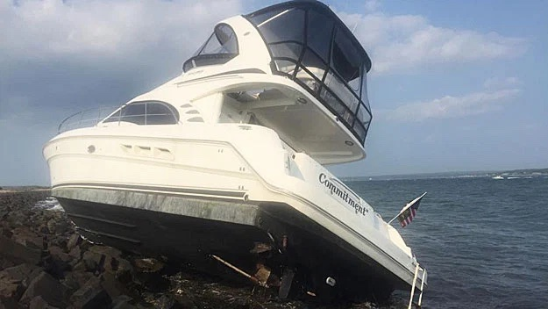
GPS Limitations
GPS is generally reliable and accurate but as with all electronics it can go wrong
Notes:
Questions:
1, We have already mentioned some of them. Can anyone remember or name any limitations of GPS?

Slide 22
Types of limitations
Device failure (battery or power failure)
Poorly sited, shielded or damaged aerial
Interruption or changes to the network of satellites
Operator error, typo when entering waypoints
Using a fix object (buoy) as a waypoint – you may hit it!
No accounting for hazards, unlike satnav, a GPS/chartplotter does not know where hazards are located.
No accounting for tide, may get pushed onto a hazard

Slide 23
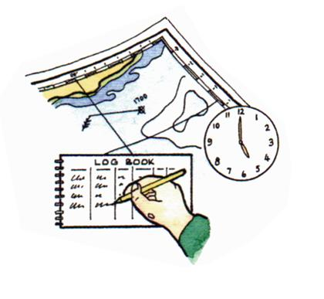
How do we mitigate
Always backup your GPS position with information from another source
  Handheld compass bearings
  Passing charted objects
  Keep a record of your position at regular intervals on the chart and in the ships log
Be vigilant, GPS is unaware of hazards around you
Notes:
Questions:
What are the limitations of GPS
What other sources can be used to confirm the GPS position?

Slide 24
Summary
We have covered the use of GPS and Chart-plotters for use as navigation aids to a Powerboating level 2 standard.
  RYA Essential Navigation & Seamanship
Remember GPSs are aids to enhance traditional navigation methods and should not be solely relied on.
Its good practice to carry paper charts and record passages in log books.

Slide 25
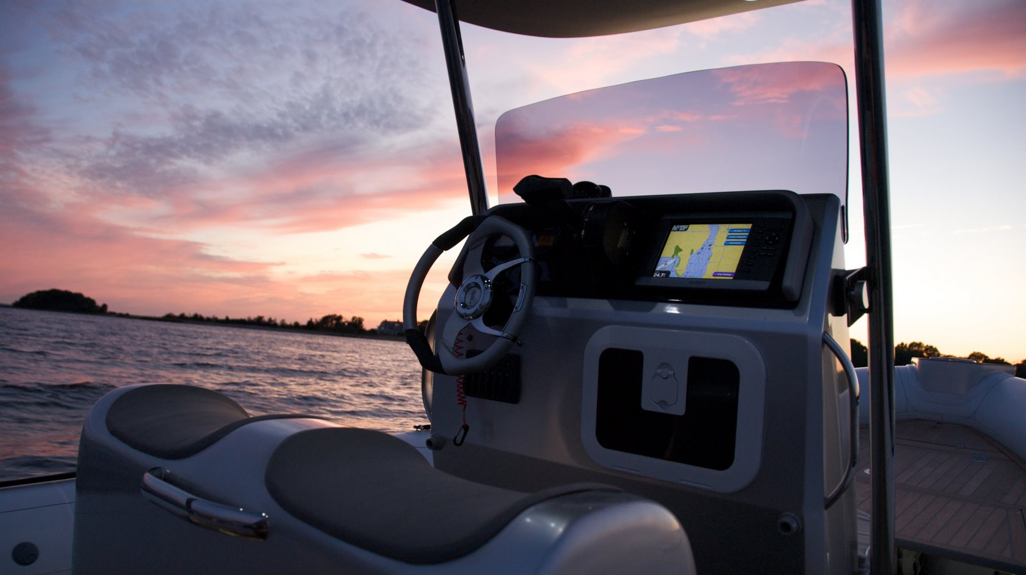
Questions ?

