Slide 1

Points of Sailing

Slide 2
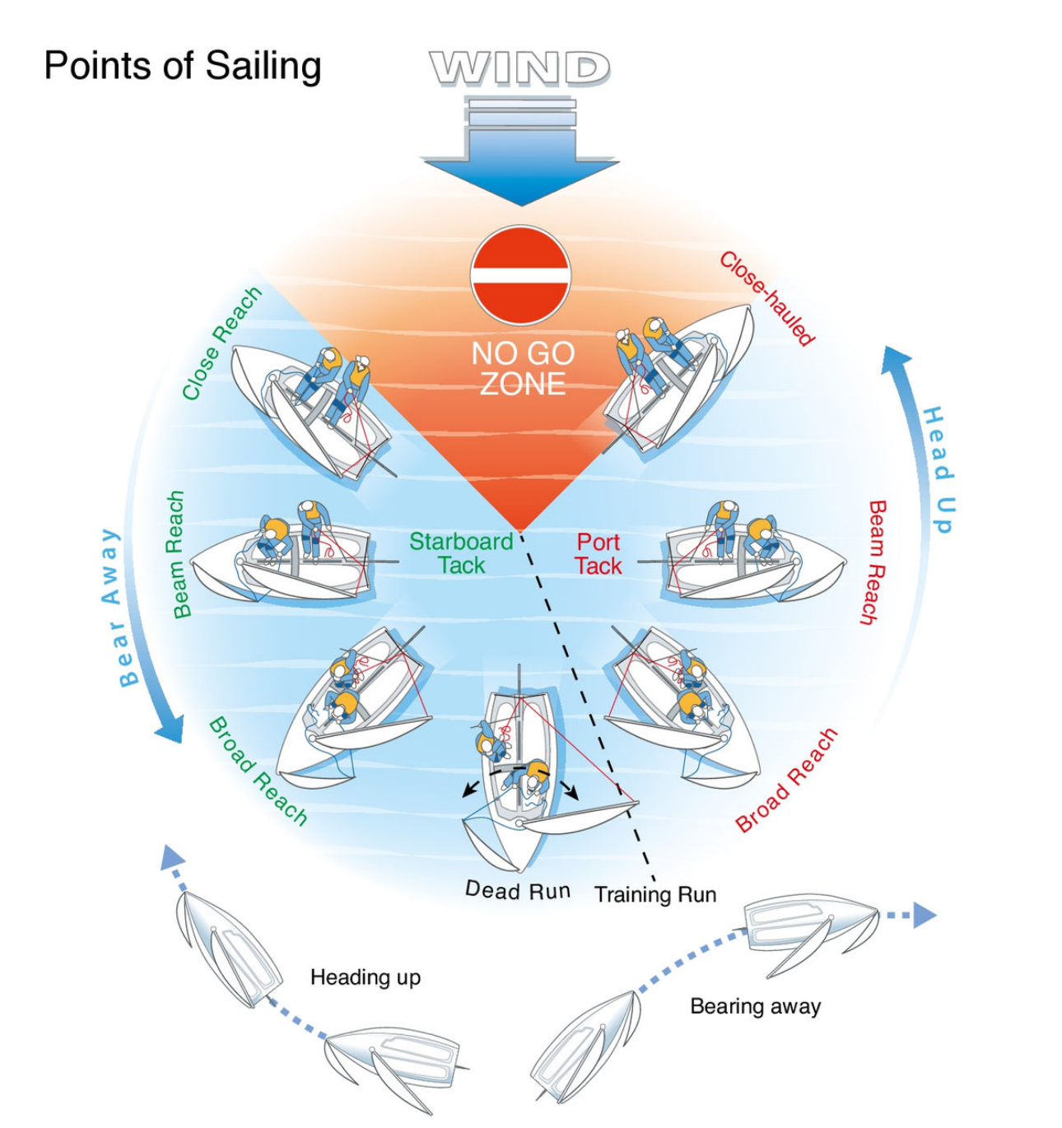

Slide 3

Points of Sailing
WIND
Heading up
Heading up
NO GO
ZONE
Starboard
Tack
Port
Tack

Slide 4
Points of Sailing
WIND
NO GO
ZONE
Starboard
Tack
Port
Tack
Bearing Away
Bearing Away

Slide 5
Points of Sailing
WIND
Heading up
NO GO
ZONE
Starboard
Tack
Port
Tack
Bearing Away
Beam Reach

Slide 6
Points of Sailing
WIND
Heading up
NO GO
ZONE
Starboard
Tack
Port
Tack
Bearing Away
Close Reach

Slide 7
Points of Sailing
WIND
Heading up
NO GO
ZONE
Starboard
Tack
Port
Tack
Bearing Away
Close Hauled

Slide 8
Points of Sailing
WIND
Heading up
NO GO
ZONE
Starboard
Tack
Port
Tack
Bearing Away
Broad Reach

Slide 9
Points of Sailing
WIND
Heading up
NO GO
ZONE
Starboard
Tack
Port
Tack
Bearing Away
Dead Run

Slide 10
Points of Sailing
WIND
Heading up
NO GO
ZONE
Starboard
Tack
Port
Tack
Bearing Away
Training Run

