Slide 1

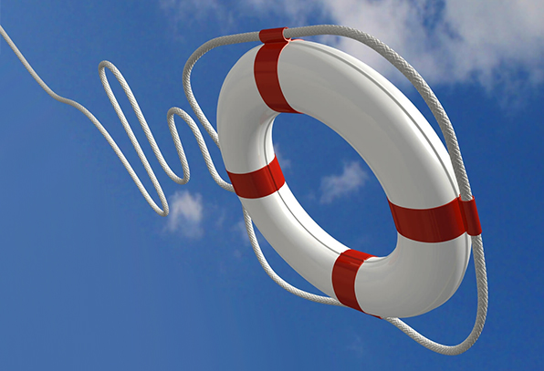
Safety on the Water
Safety matters – the Seven Common Senses
Before you go out and during your on-water session you should:
Check the conditions
Check your equipment
Check yourself

Slide 2
Safety on the Water
Safety matters – the Seven Common Senses
1, Is all your equipment seaworthy and suitable?
Clothing: make sure you are wearing suitable clothing to keep you warm and comfortable during your sailing session.
The most common cause of need for rescue is component failure.
Boat and rigging: Check the integrity of the boats hull and rig, ensuring all ropes are secure and in good condition
Essential Spares: You should carry with you spare rigging/tow line and a means of attracting attention, such as a whistle.

Slide 3
Safety on the Water
Safety matters – the Seven Common Senses
2, Tell someone where you are going and when you will be back.
It is recommended that you always sail at a venue that has safety provision and, as an extra safety precaution, always ensure that a responsible person knows that you have gone on the water and that you have returned.

Slide 4
Safety on the Water
Safety matters – the Seven Common Senses
3, Obtain a forecast for the local sailing area.
To avoid being caught out by changing conditions, get a forecast. If you are sailing at a new location it is advisable to seek advice from experienced local sailors.

Slide 5
Safety on the Water
Safety matters – the Seven Common Senses
4, Are you capable of handling prevailing conditions.
Ensure you are adequately experienced to handle the conditions you are going out in. Developing your skills in more challenging conditions should be done at a safe location which ideally has safety provision. If in doubt, don’t go out.

Slide 6
Safety on the Water
Safety matters – the Seven Common Senses
5, Sail with others.
Its more fun to sail with others. Not only do you learn from a sailing buddy but there will always be someone close by should you need a hand.

Slide 7
Safety on the Water
Safety matters – the Seven Common Senses
6, Avoid strong tides, offshore winds and poor visibility.
Offshore winds and strong tidal streams can sweep you away from the safety of your chosen sailing area. It is essential that you understand the conditions you are sailing in and what consequences could occur.
Poor visibility is best avoided as it prevents you from seeing dangers and others from seeing you should you get into difficulty.

Slide 8
Safety on the Water
Safety matters – the Seven Common Senses
7, Consider other water users.
Many sailing locations are busy with other water users. You should respect others on the water by giving them space and taking all necessary action to avoid collision.

Slide 9
Safety on the Water
Safety Equipment
Sailing is generally a very safe sport but, if you decide to sail in a location that is not an RYA Recognised Training Centre with designated safety cover, it is important to carry the appropriate safety equipment and know how to summon assistance if necessary.
The type and amount of gear you need will depend on the boat you sail and where you go afloat. A paddle to get you home if the wind drops may suffice if you sail on inland waters. If you sail on coastal waters, carry an anchor with sufficient line in case of a breakdown or lack of wind. Folding anchors are easiest to stow on a small boat.
If your boat is fitted with an engine or gas fuelled cooking equipment you should have a fire extinguisher on board. A small first-aid kit stowed in a waterproof container is useful in case an injury needs treatment before you can get ashore. Whatever equipment you carry, keep it in good condition and make sure that you know how to use it.

Slide 10
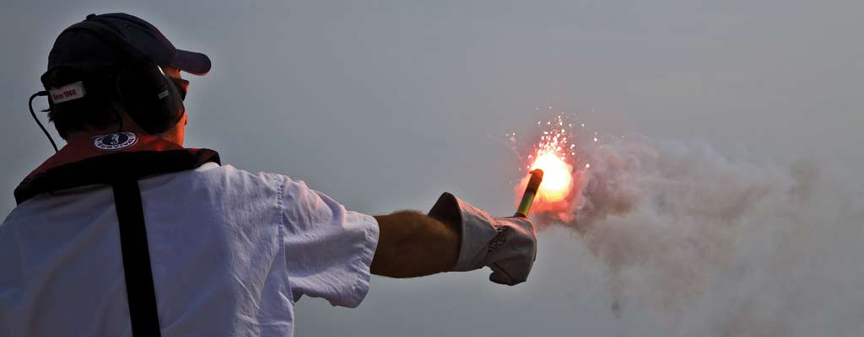
Safety on the Water
How to Summon Help
If a situation develops beyond the point where you can deal with it, seek outside assistance.
If you sail on inland waters you may be able to attract attention by shouting.
If you sail on coastal waters carry flares and keep them dry.
Read the instructions and explain to your crew how to use flares before the need arises.

Slide 11
Safety on the Water
Sailing in Coastal Waters
Coastal waters provide some wonderful sailing venues with the opportunity for good racing or day sailing. Care should be taken as waves can develop quickly on the sea when the wind reaches Force 3 or more, especially in open waters.
Before you go afloat in coastal waters, check the weather forecast for several hours ahead and ensure the conditions will be within your capabilities. Additionally, check the time of high and low water, and find out the direction of the tidal stream during the time you plan to be sailing.
You can find the times of high and low water in a local tide table, and the direction of the tidal stream from a pilot guide, tidal atlas or chart of the area. It is best to sail from an RYA Recognised Training Centre but, if you do go out, if you are in any doubt, ask an experienced local sailor for advice. Tell a reliable person of your plans and the time you expect to be back so they can notify the rescue services if you do not return in time.

