Slide 1


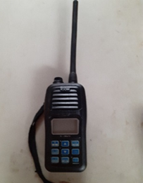
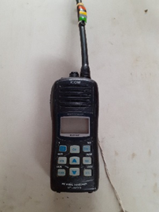
VHF RADIO SETS – FOSSC
ICOM 33 ICOM 23
WHY VHF
WHAT it is
Licence/Certification
Familiarisation

Slide 2
WHY
Safety – alert attention and direct the reponse quickly
Efficient communication - between OODs and safety boat crews
Sail Training – co-ordination between different groups on the water
Can address more than one person at a time
Good coverage
Easy and quick to use

Slide 3
WHAT IS VHF?
Very High Frequency – 30MHz – 300MHz which is divided into a series of designated frequencies.
The standard frequencies have been given 2-digit channel numbers including channel 16 which is the Distress, Safety and Calling channel.
The UK government have allocated 2 channels for use as private channels these are M (P1 or 37), M2 (P2/P4) and FOSSC sets transmit on these channels only.

Slide 4
LICENCE and CERTIFICATION
Various types of licence are available.
FOSSC hold Ship Portable Radio Licences for each VHF radio set.
As FOSSC radio sets are limited to private channels a user is not required to hold an operator’s certificate.

Slide 5
FEATURES
FOSSC ICOM 23 and 33
Waterproof to 1 metre for 30 minutes
Buoyant
“Aquaquake” feature – push and hold both ‘SCAN’ and ‘H/L’. This is most effective when activated as soon as the radio is retrieved from the water.
Range – determined by the antenna height above the water
Simplex channels – this means that only one person can talk at a time. It is important that you release the ‘push to talk PTT’ switch when you finish speaking. The last word used should be ‘over’ if you expect a reply, or ‘out’ if you do not.
Further information and guidance can be found in the Club Operating Guide and by enrolling on a VHF course.

Slide 6
Finally
Do remember that you can be overheard by anyone listening on the same channel
Speak clearly but normally
Radio users are duty bound to respect the confidences of their counterparts

